Slide 1
Topic : Concepts of Simulation
What is simulation?
What is system?
System environment?(Components of system, types of system environment)
Continuous vs discrete systems?
Real Time Simulation
Model of a system(Types of system model)
Steps in simulation study
Advantage of simulation
Limitations/disadvantage
Application

Slide 2
What is simulation?
A Simulation is the imitation(artificial) of the operation of a real-world
process or system over time
or
Simulation is the process of creating a model or representation of a real-world system or process and running experiments or observations on that model to understand its behavior, make predictions, or analyze outcomes without directly interacting with the actual system.
Simulation is used before an existing system is altered or a new system built.

Slide 3
why???
To reduce the chances of failure to meet specifications,
To eliminate unforeseen bottlenecks,
To prevent under or over-utilization of resources,
To optimize system performance

Slide 4
What is system?
The term system is derived from the Greek Word systema, which means an organized relationship among functioning units or components.
A system is a collection of interrelated components or elements that work together to achieve a specific goal or perform a function.
For example:-Production system for manufacturing automobiles.

Slide 5
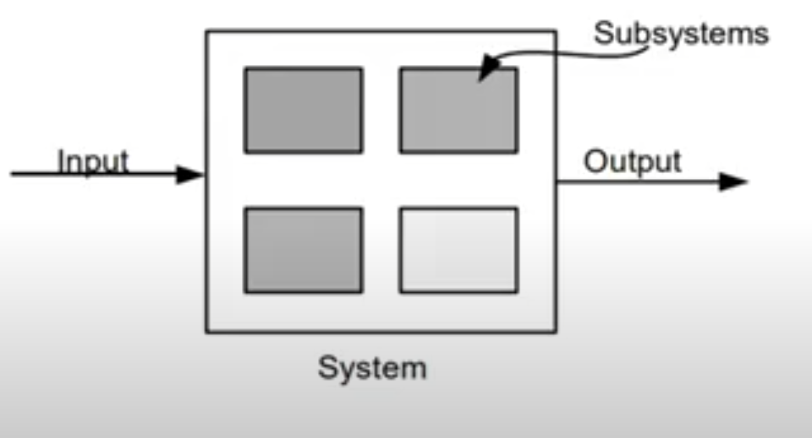
A system exists and operates in time and space.

Slide 6
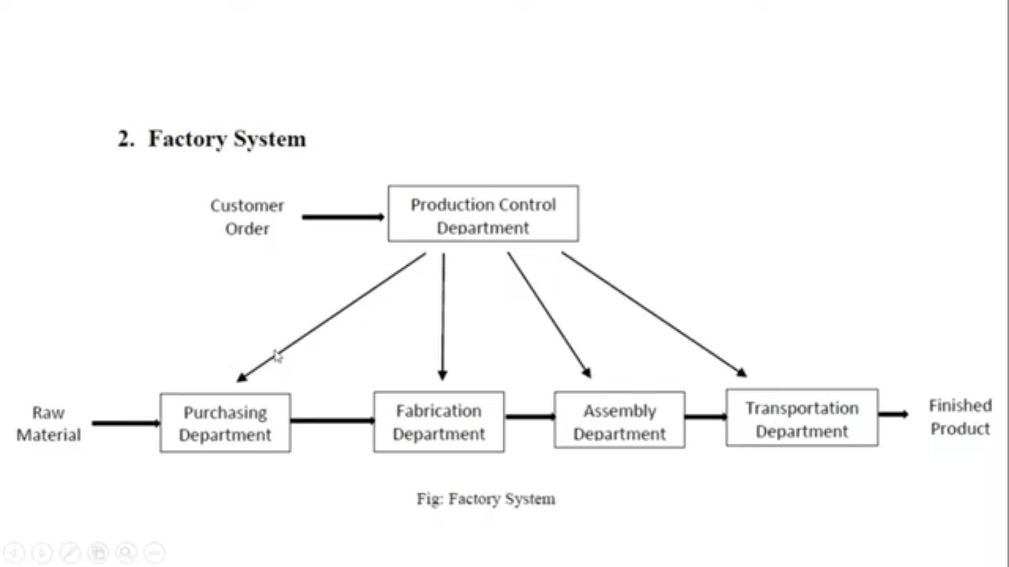

Slide 7
Components of a system
Entity: An entity is an object of interest in a system.EX:In the factory system,dpeatments, orders,parts and products are the entities.
Attribute:An attribute denotes the property of an entity. EX: Quantities for each order,type of part, or number of machines in a Department are attributes of factory system.
Activity: Any process causing changes in a system is called as an activity.EX: Manufacturing process of the department.

Slide 8
State of the System: The state of a system is defined as the collection of variables to describe a system at any time ,relative to the objective of study. In other words, state of the system mean a description of all the entities, attributes and activities as they exist at one point in time.
Event: An event is defined as an instantaneous occurrence that may change the state of system.

Slide 9
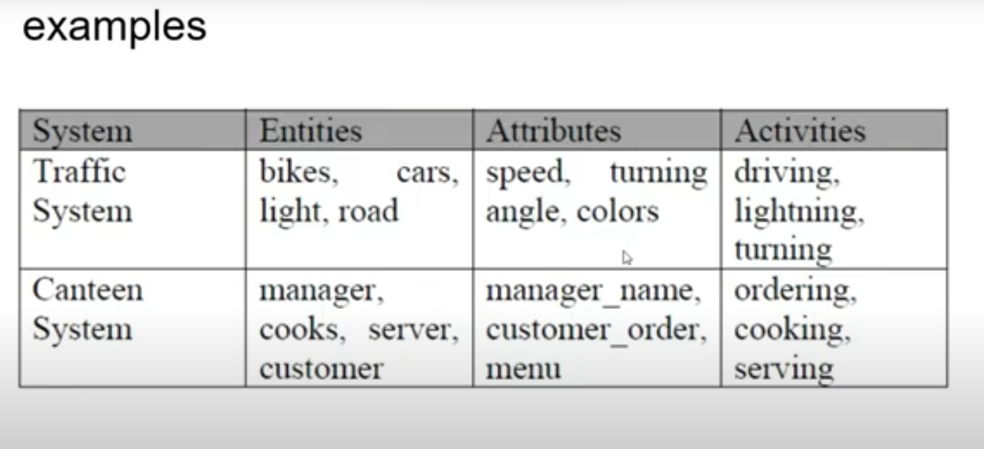

Slide 10
System Environment
The external components which interact with the system and produce necessary changes are said to constitute the system environment.

Slide 11
Ex: In a factory system, the factors controlling arrival of orders may be considered to be outside the factory but yet a part of the system environment. When, we consider the demand and supply of goods, there is certainly a relationship between the factory output and arrival of orders. The relationship is considered as an activity of the system.

Slide 12
Types of system environment
Endogenous system: The term endogenous is used to describe activities and events occurring within a system. Ex: Drawing a cash in a bank.
Exogenous system: The term exogenous is used to describe activities and events in the environment that affect the system.EX:Arrival of customers.
Closed System: A system for which there is no exogenous(No External) activity and event is said to be a closed.Ex:Water in an insulated flask.

Slide 13
Open System: A system for which there is exogenous (External) activity and event is said to be a open. Ex: Bank system.

Slide 14
Discrete system vs Continuous system
Discrete System: A discrete system is one in which the state variable(s) change only at a discrete set of points in time.
So, A discrete system is one for which the state variables changes instantaneously (immediately) at separate point of time.E.g. Factory System, Bank System.

Slide 15
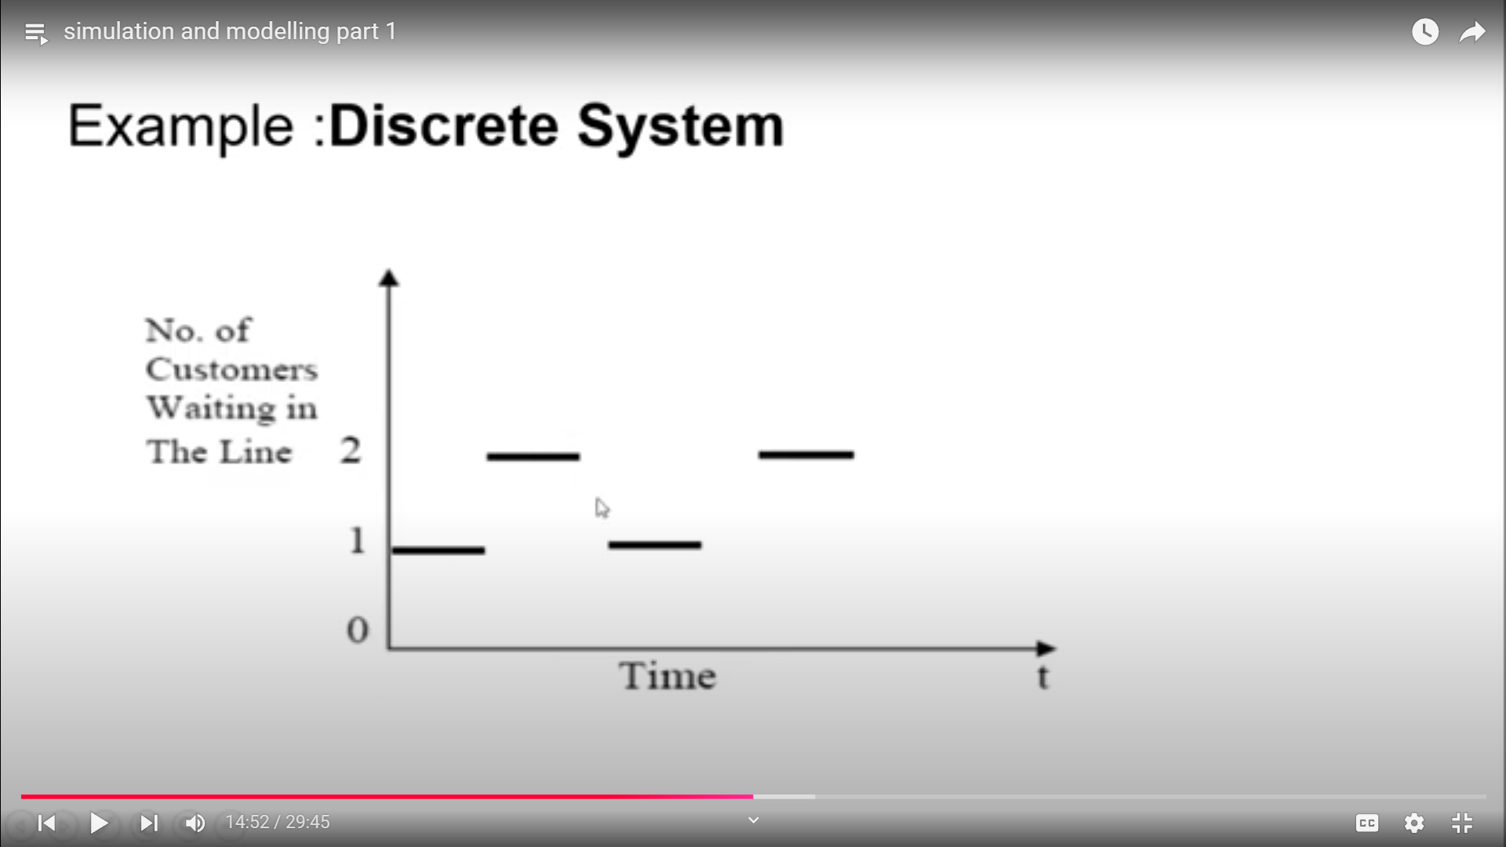
Example: Discrete System

Slide 16
Continuous System
A continuous system is one which the state variable(s) change continuously over time.
i.e. A continuous System is one for which the state variables changes continuously with respect to time. E.g. Head of Water behind the dam.

Slide 17
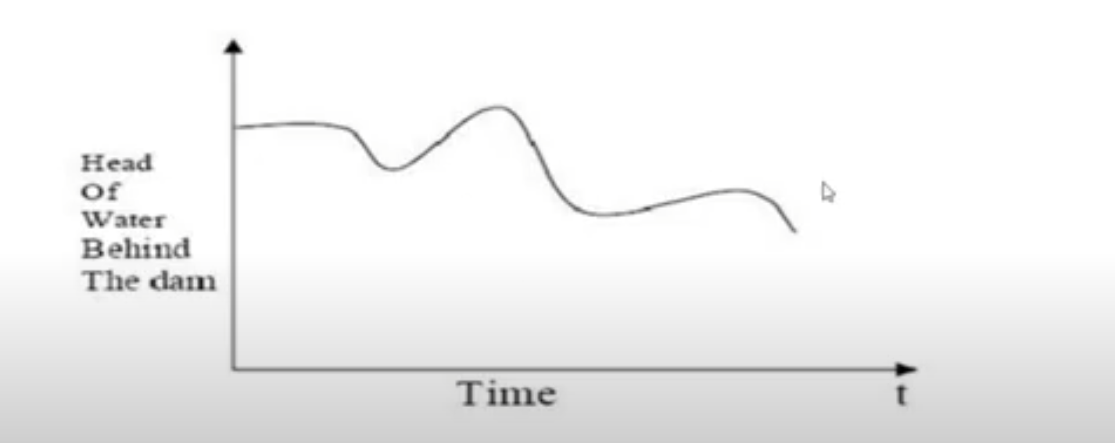
Example Continuous system

Slide 18
REAL TIME SIMULATIONS
Real time simulatipn refers to a computer model of a physical system that can execute at the same rate as actual “Wall clock” time.
In other words, the computer model runs at the same rate as the actual physical system.
For example: if a tank takes 10 minutes to fill in the real world, the simulation would take 10 minutes as well.

Slide 19
Model of a system
A model is defined as a representation of a system for the purpose of studying the system.
It is simplification of the system

Slide 20
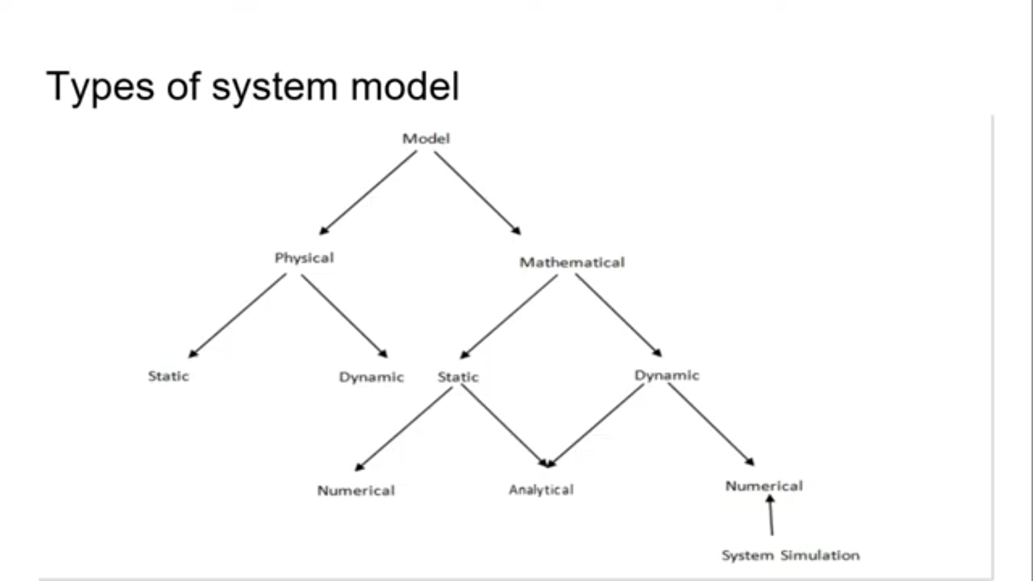

Slide 21
On details:
Physical models: are based on some analogy between systems like mechanical and electrical. The system attributes are represented by such measurements like voltage.
Mathematical models: use symbolic notation and mathematical equations to represent the system attributes .The attributes represented by variables and activities by mathematical functions that inter-relate the variables.

Slide 22
Static models: can only show the values that system attributes take when system is in balance.
Dynamic model: follow the changes over time that result from system activities.
Applying analytical: techniques means using the deductive(logical) reasoning of mathematical theory to solve a model. For E.g. linear differential equation
Numerical methods: involves applying conceptual(theoretical) procedures to solve equations.

Slide 23
Steps in simulation study:
1.Problem formulation
2.Setting of Objectives and overall project plan
3.Model conceptualization
4.Data collection
5.Model translation
6.Verified
7.Validated
8.Experimental Design
9.Production runs and analysis
10.More runs
11.Documentation and reporting
12.implementation

Slide 24
1.Problem Formulation(Invention)
Every study begins with a statement of the problem, provided by policy makers.
Analyst ensures its clearly understood. If it is developed by analyst policy makers should understand and agree with it

Slide 25
2.Setting of objectives and overall project plan
The objectives indicate the questions to be answered by simulation
At this point a determination should be made concerning whether simulation is the appropriate methodology.

Slide 26
3.Model conceptualization
The construction of a model of a system is probably as much art as science.
Thus , it is best to start with a simple model and built toward greater complexity.Model conceptualization enhance the quality of the resulting model and increase the confidence of the model user in the application of the model.

Slide 27
4.Data collection
There is a constant interplay between the construction of model and the collection of needed input data. Done in the early stages.
Objective kind of data are to be collected.

Slide 28
5.Model translation
It can be programmed by using simulation languages or special purpose simulation software.
Simulation languages are powerful and flexible. Simulation software models development time can be reduced.

Slide 29
6.Verified
It pertains to be computer program and checking the performance.
If the input parameters and logical structure are correctly represented , verification is completed.
A=5,b=7 a + b=13
(system right)

Slide 30
7.Validated
It is the determination that a model is an accurate representation of the system.
a=5,b=7
a + b=12
(right system)

Slide 31
8.Experimental Design
The alternatives that are to be simulated must be determined. Which alternative to simulate may be a function of runs

Slide 32
9.Production runs and analysis
They are used to estimate measures of performance for the system designs that are being simulated.

Slide 33
10.More runs

Slide 34
11.Documentation and reporting
Program documentation: can be used again by the same or different analysts to understand the program operates. Further modification will be easier .Model users can change the input parameter for better performance.
Process documentation: Gives the history of a simulation project. The result of analysis should be reported clearly and concisely in a final report. This enable to review the final formulation and alternatives, results of the experiment and the recommend solution to the problem. The final reports provide a vehicle of certification.

Slide 35
12. Implementation
Success depends on the previous steps. If the model user has been thoroughly involved and understands the nature of the model and its outputs, likelihood of a vigorous implementation is enhanced

Slide 36
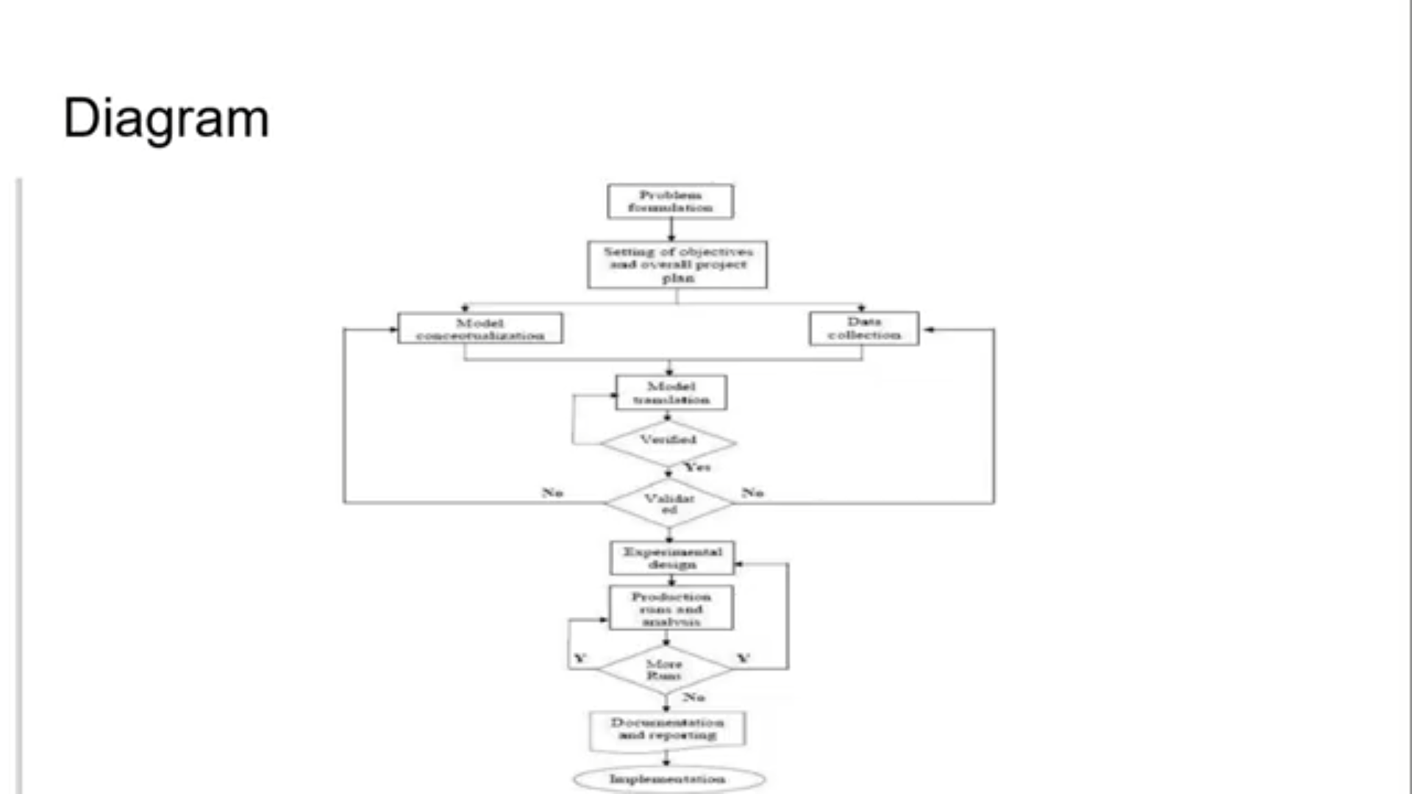

Slide 37
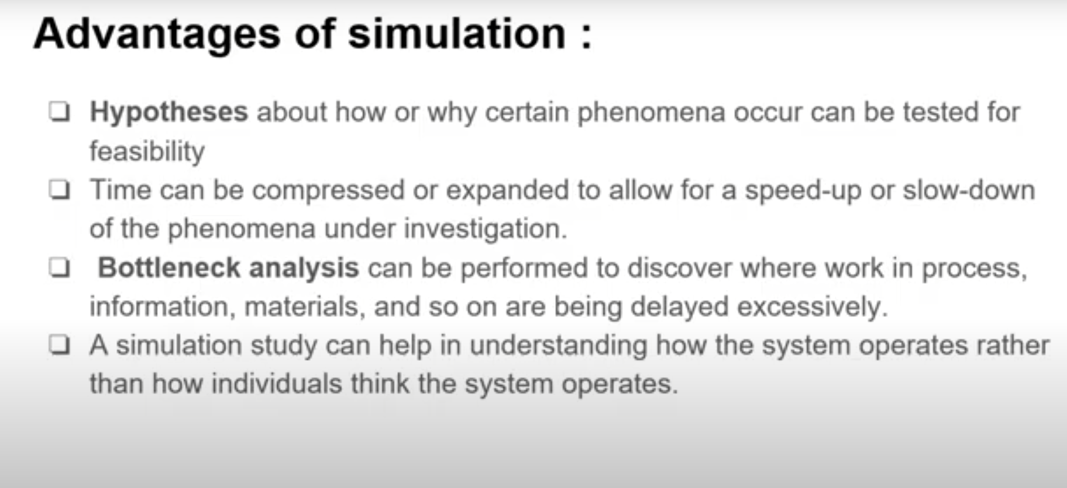

Slide 38
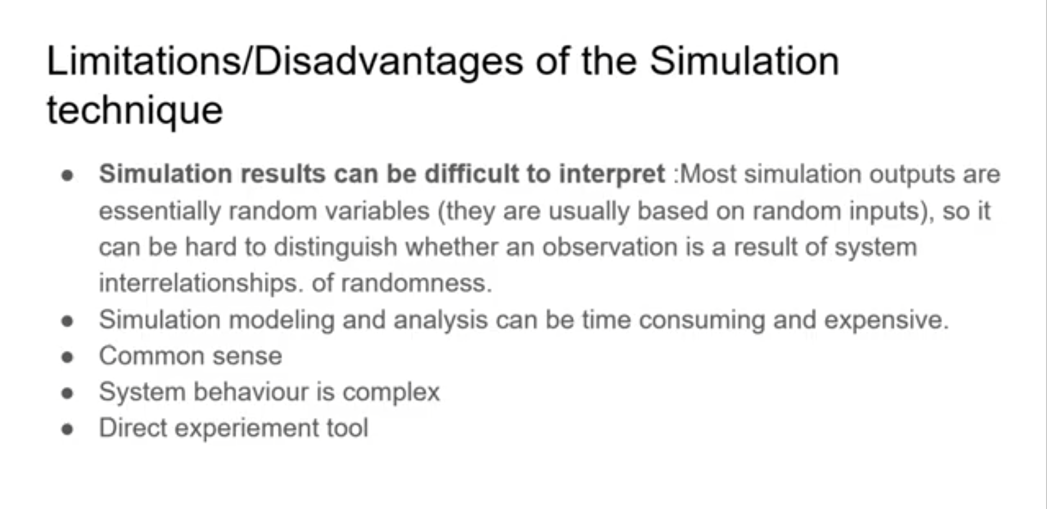

Slide 39
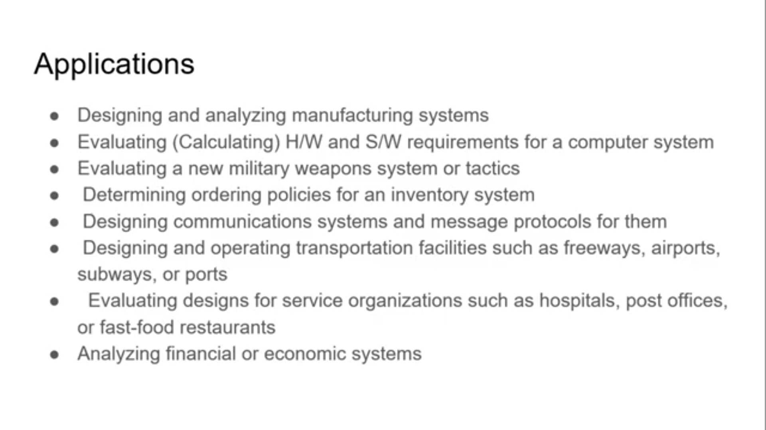

Slide 40
Manufacturing Applications
Analysis of electronics assembly operations
Design and evaluation of a selective assembly station for high precision scroll compressor shells
Comparison of dispatching rules for semiconductor manufacturing using large-facility models.
Evaluation of cluster tool throughput for thin-film head production

Slide 41
Semiconductor manufacturing
Comparison of dispatching rules using large-facility models
The corrupting influence of variability
A new lot-release rule for wafer fibs
Assessment of potential gains in productivity due to proactive reticle management

Slide 42
Construction Engineering
Construction of a dam embankment
Trenchless renewal of underground urban infrastructures
Activity scheduling in a dynamic ,multi project setting
Investigation of the structural steel erection process

Slide 43
Military Application
Modeling leadership effects and recruit type in an Army recruiting station
Design and test of an intelligent controller for autonomous underwater vehicles
Modeling military requirements for non war fighting operations
Multi trajectory performance for varying scenario sizes

